Slide 1

Elderly victims

Slide 2
Elder abuse
Definition: harm perpetrated against an older person by someone in a special relationship to them, including:
Physical abuse such as slapping, pushing, beating or forced confinement;
Financial abuse such as stealing, fraud, extortion and misusing a power of attorney;
Sexual abuse as sexual assault or any unwanted form of sexual activity;
Neglect as failing to give an older person in your care food, medical attention or other necessary care, or abandoning an older person in your care; and
Emotional abuse as in treating an older person like a child or humiliating, insulting, frightening, threatening or ignoring an older person (ACE 2013).

Slide 3
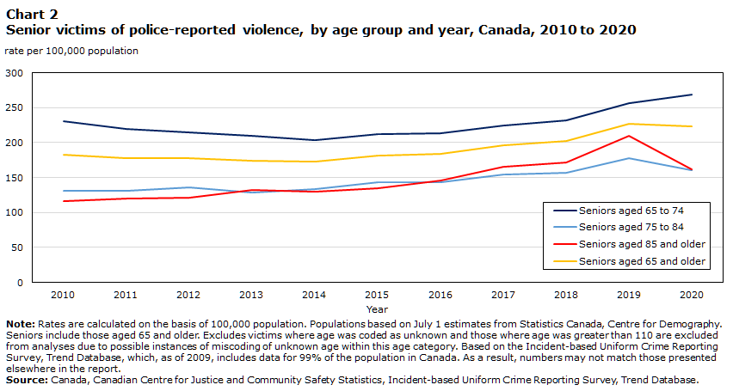

Slide 4
Overview – Violence stats (StatsCan 2022)
There were about 128,000 senior victims of violence in Canada in 2019.
Overall, three-quarters (76%) of seniors who reported experiencing violent victimization in 2019 were physically assaulted.
The rate of police-reported violence against seniors increased 22% between 2010 and 2020, with the largest increase observed in the past five years among senior men.
In 2020, nearly two-thirds (64%) of senior victims of police-reported violence were victimized by someone other than a family member or intimate partner. Acquaintances were implicated for more than one in four (28%) senior victims of violence while one-quarter (24%) of senior victims were victimized by stranger.
Senior women who experienced police-reported violence were twice as likely to have been victimized by an intimate partner compared with senior men (16% versus 7%).
More than half (60%) of all police-reported violence against seniors involved the use of physical force and an additional 19% involved the presence of a weapon.
The rate of police-reported violence was higher for senior men than senior women in every province and territory in 2020, and in nearly all census metropolitan areas.
In 2020, the overall rate of police-reported senior victimization in the provinces was higher in rural compared to urban areas (247 versus 214 per 100,000 population).
Between 2000 and 2020, 944 seniors were victims of homicide in Canada, which accounted for 7% of all homicide victims during this time. The homicide rate among seniors increased between 2010 and 2020 (+9%), driven by the homicides of senior men (+28%).
Among senior men who were homicide victims, two-thirds (67%) were killed by a non-family member, most commonly a friend (30%) followed by a stranger (20%) or an acquaintance (17%). Among senior women who were homicide victims, two-thirds (67%) were killed by an intimate partner (32%) or family member (35%), while one in eight (13%) senior women were killed by a stranger.

Slide 5
Risk factors (Cdn Research Ctr for Victims of Crime)
● The senior citizen is socially isolated, especially due to physical disabilities or impairment.
● The victim suffers from some form of mental impairment, for example, dementia.
● The senior citizen has substance abuse problems, for example, alcohol or medication.
● Language barriers for the elderly person.
● Cultural barriers for the elderly person.
● Being a woman; women are at a greater risk of being victimized.

Slide 6
AREAS OF GREATEST VULNERABILITY FOR SENIORS
Financial crimes by strangers. A variety of fraudulent schemes fall in this category, including Ponzi schemes (investment), false promises of prizes, aggressive telemarketing, schemes involving health products, and fraudulent home repairs.
Crime and abuse by relatives and caregivers. This includes the full range of crime and abuse, including physical, emotional, and sexual abuse, as well as financial exploitation and neglect.
Crime and abuse in institutional settings (nursing homes). Again, physical, sexual, and emotional abuse, as well as systemic abuse. (Gabor and Kiedrowski 2009).

Slide 7
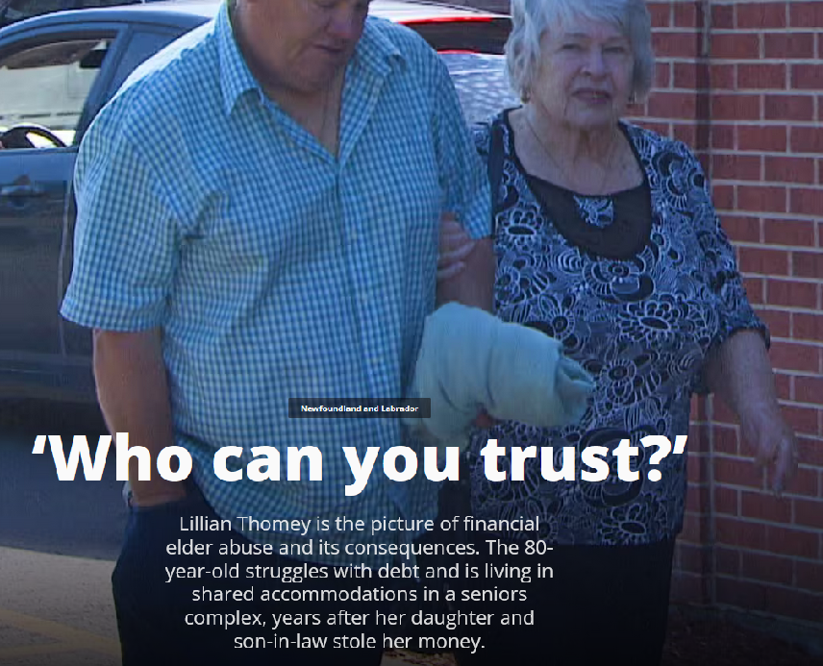
Fraud and senior citizens

Slide 8
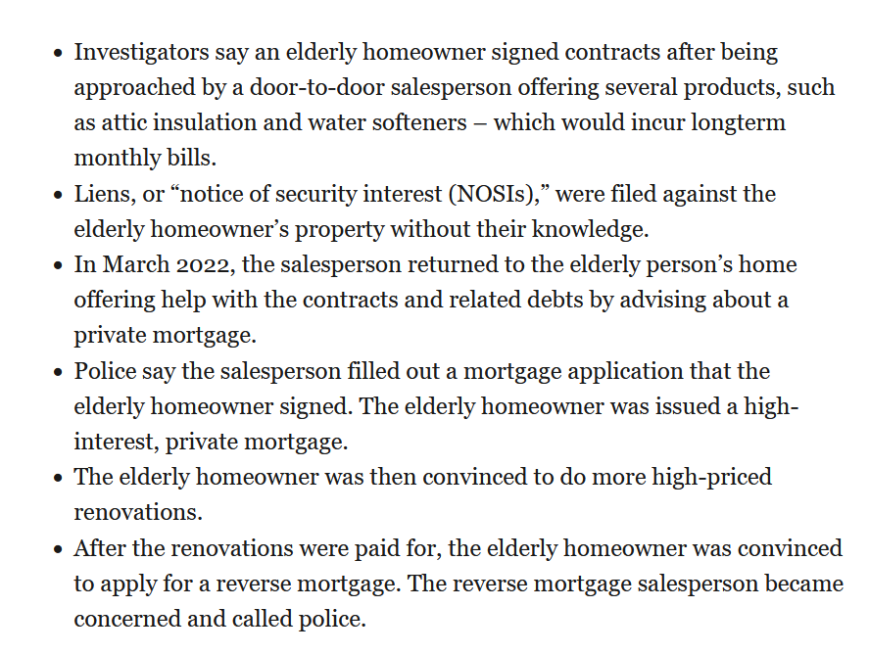
Recent London case:

Slide 9
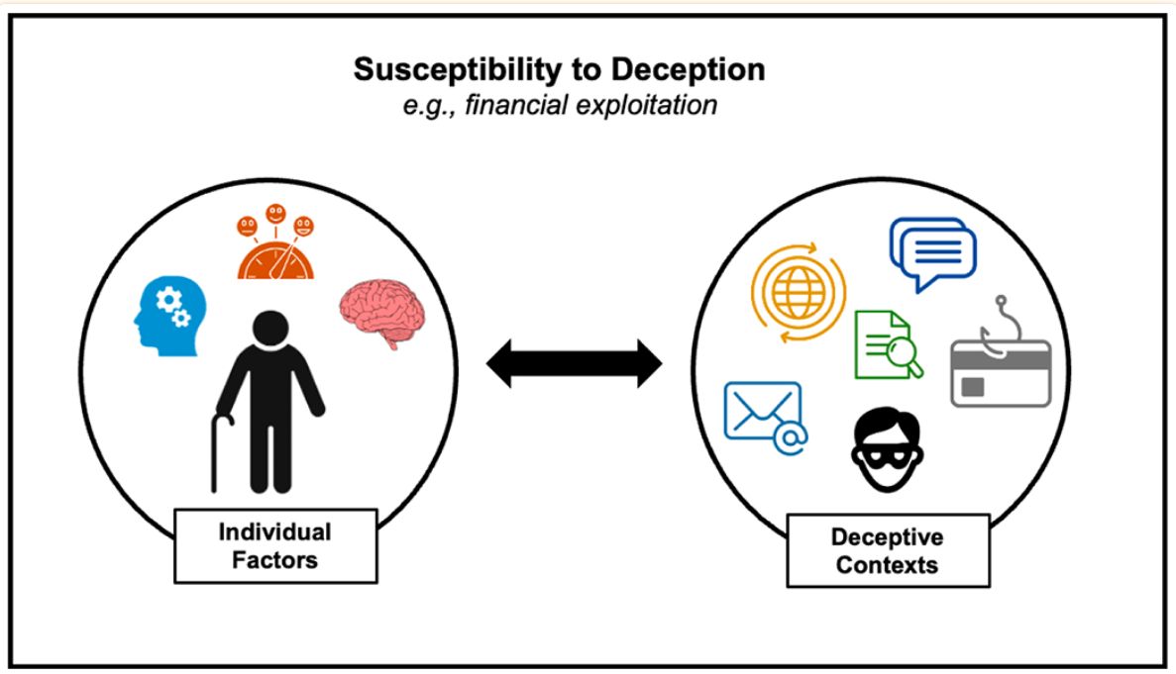
Ebner et al. 2023
Loneliness, cognitive declines, dementia, declining deception detection

Slide 10
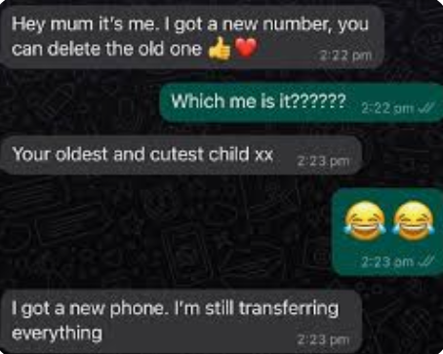
Text scam:

Slide 11
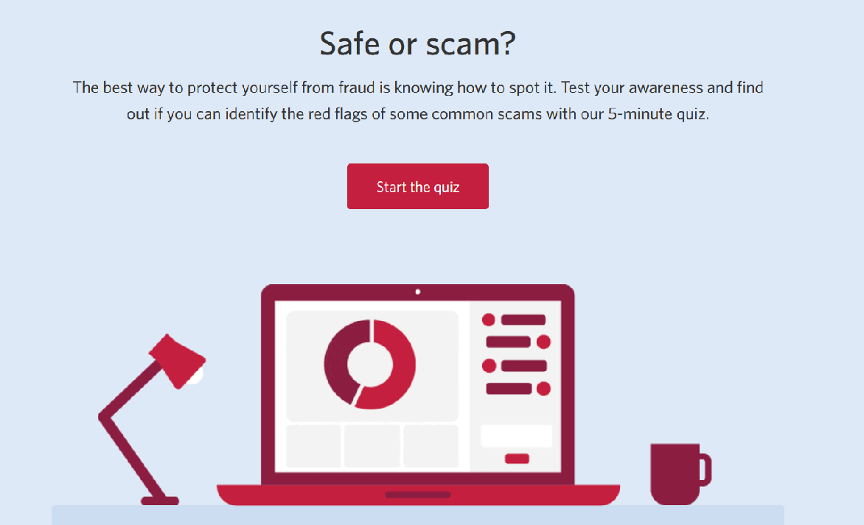
Safe or scam?
https://www.cibc.com/en/privacy-security/banking-fraud/scam-quiz.html

Slide 12
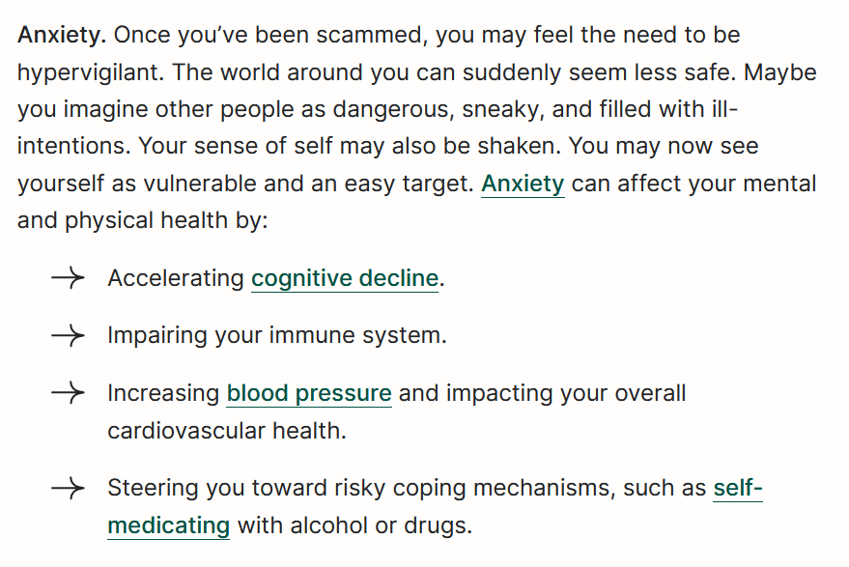
Impacts of financial fraud on elderly
Can be emotionally and psychologically devastating.
One of the more common impacts (Reid 2024):

Slide 13
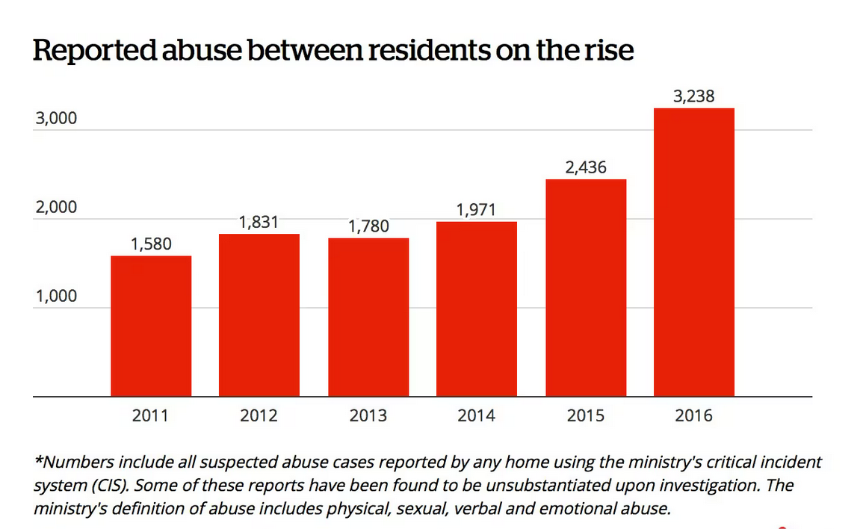
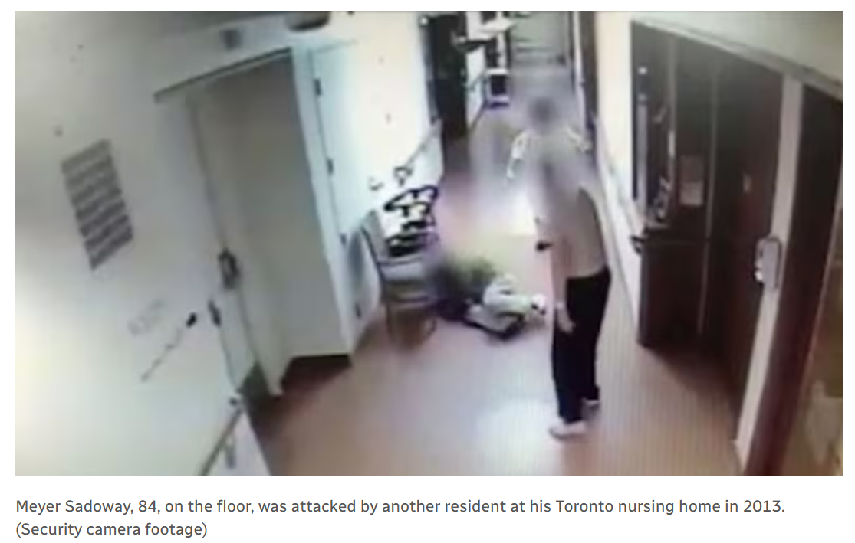
Care facilities – resident on resident
Source: CBC News

Slide 14
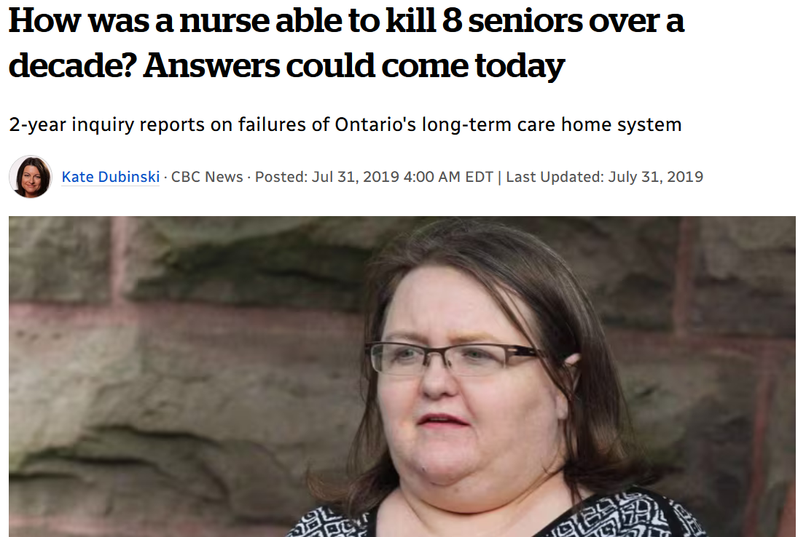
Care facilities - staff
Elizabeth Wettlaufer was a nurse at several long-term care facilities in southwestern Ontario, including London. She killed patients by giving them lethal doses of insulin.
How was she caught? She quit her nursing job in 2016, checked into a psychiatric hospital and confessed her crimes.

Slide 15

*all done!*

